Slide 1


Programming language(Python)

Slide 2
Agenda
What is a programming language
Installing Python and code editor
Python basic syntax
Build simple calculator using Python
Reading materials

Slide 3
What is a programming language
Programming (also known as coding) is the process of writing instructions to a device, such as a computer or mobile device.
We write these instructions with a programming language, which is then interpreted by the device
These sets of instructions may be referred to by various names, but program, computer program, application (app), and executable are a few popular names.
A program can be anything that is written with code; websites, games, and phone apps are programs

Slide 4
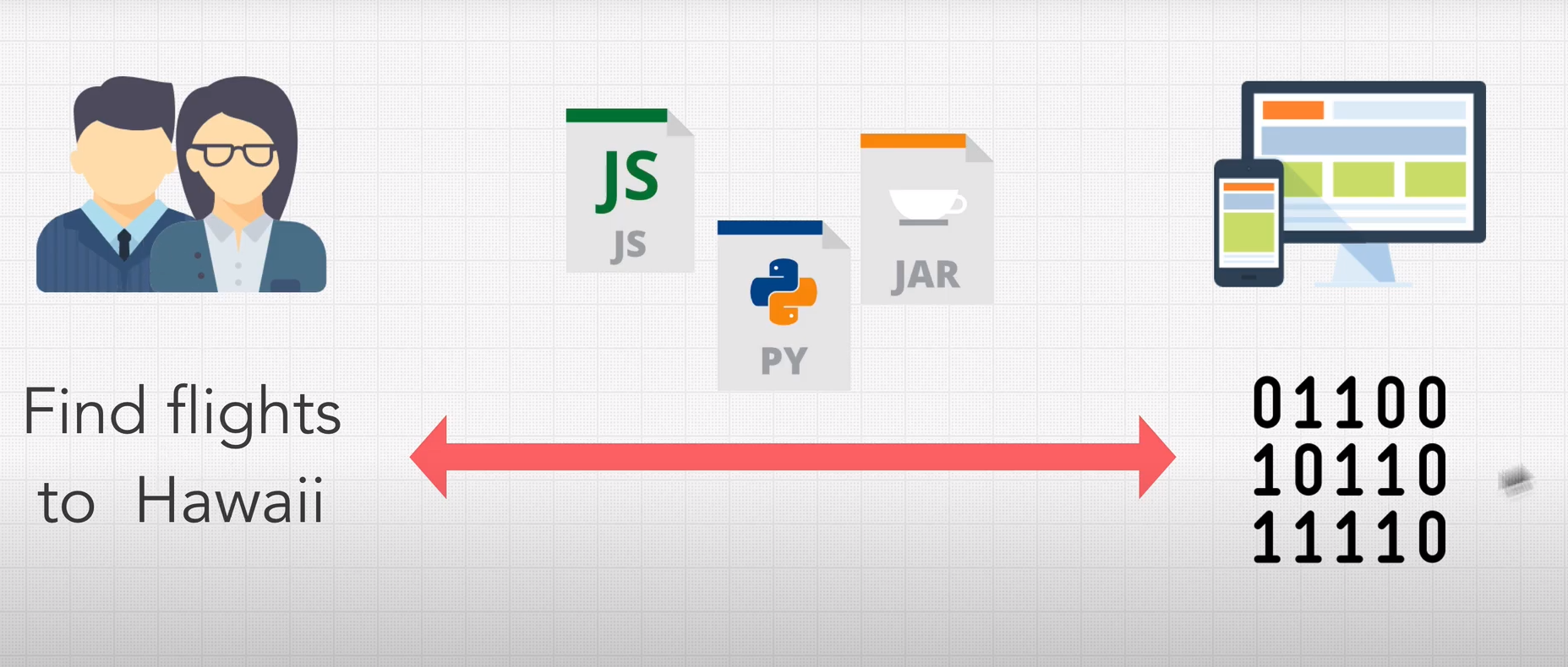
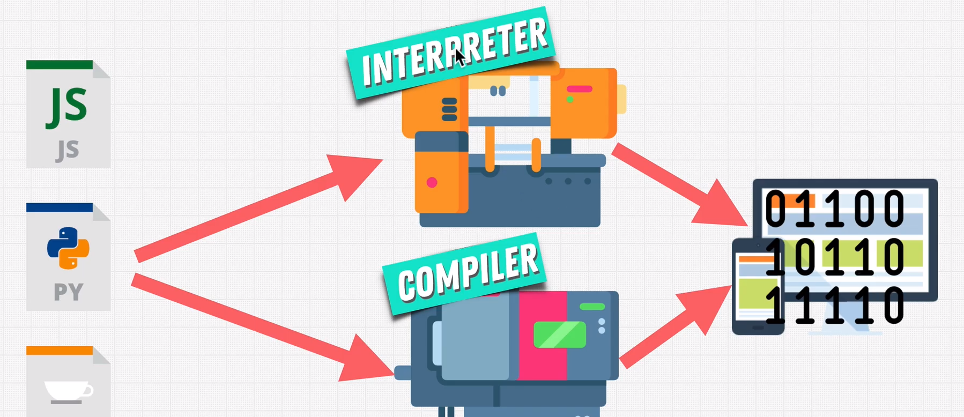
How do programming languages work
You write code to tell it what to do
The code is compiled, which turns it into machine code the computer can understand.
The computer executes the code
Interpreter translates just one statement of the program at a time into machine code. Compiler scans the entire program and translates the whole of it into machine code at once

Slide 5
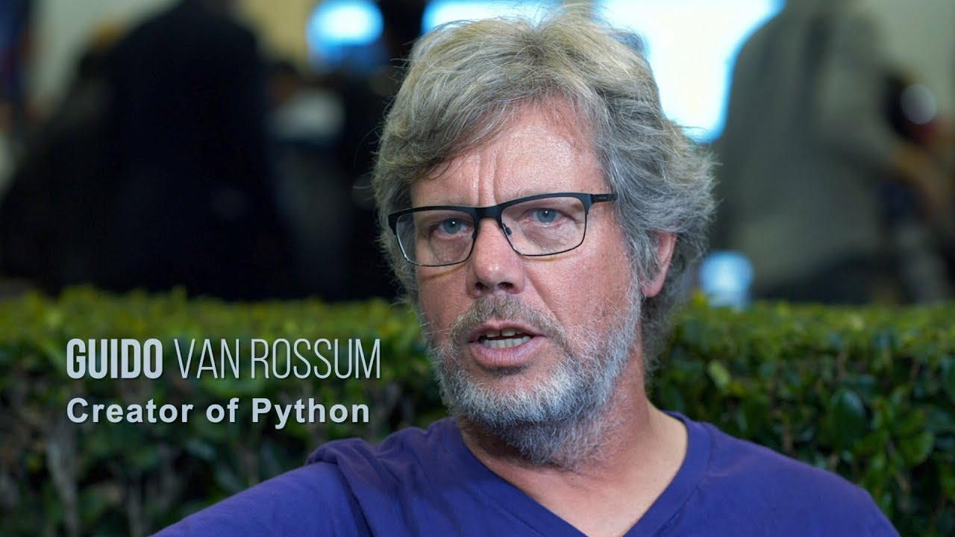
Python
Python is a general-purpose interpreted, interactive, object-oriented, and high-level programming language.
Created by Guido van Rossum, first released it in 1991 as Python
Python is designed to be highly readable. It uses English keywords frequently where as other languages use punctuation

Slide 6
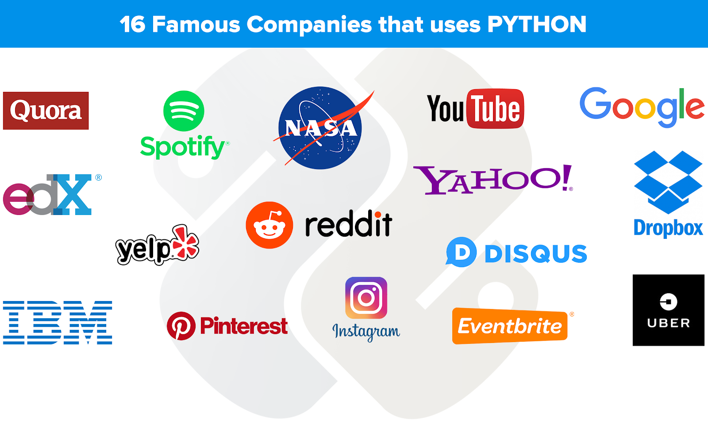

Slide 7
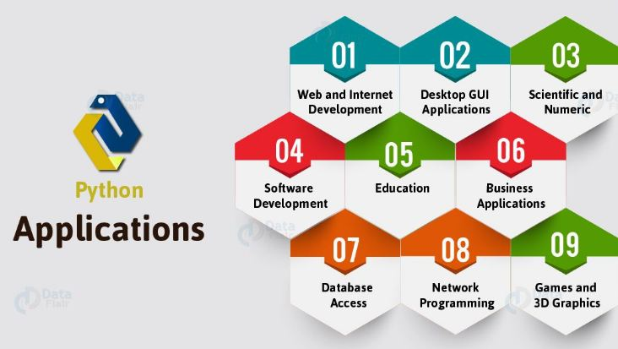

Slide 8
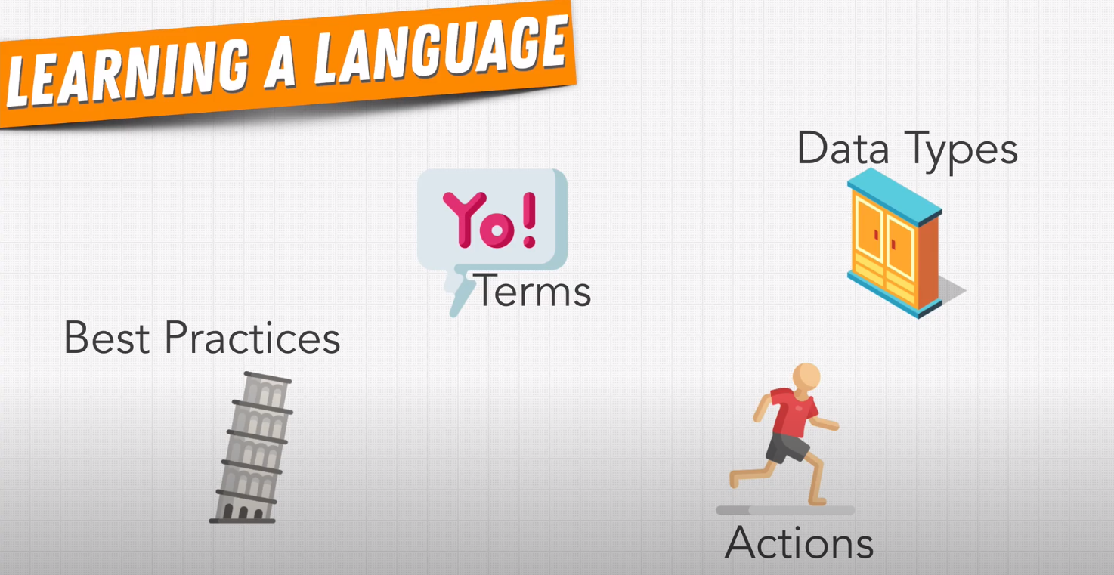
What to master when learning a programming language

Slide 9
Download Python
https://www.python.org/

Slide 10
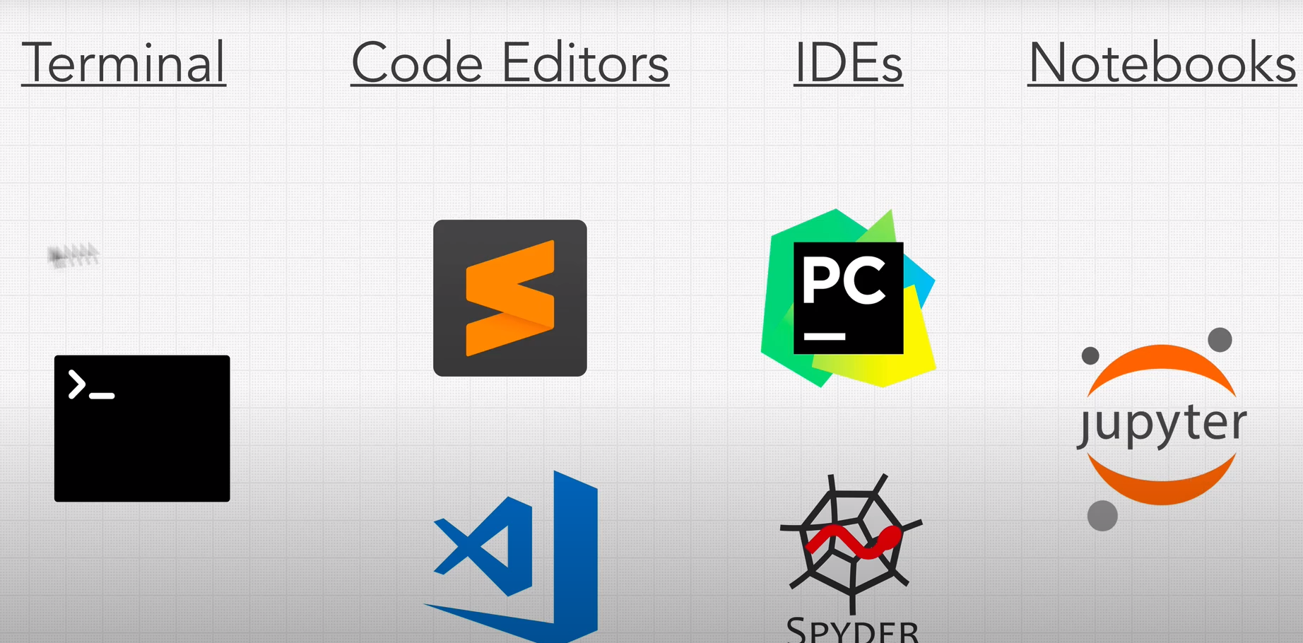
Writing python code

Slide 11
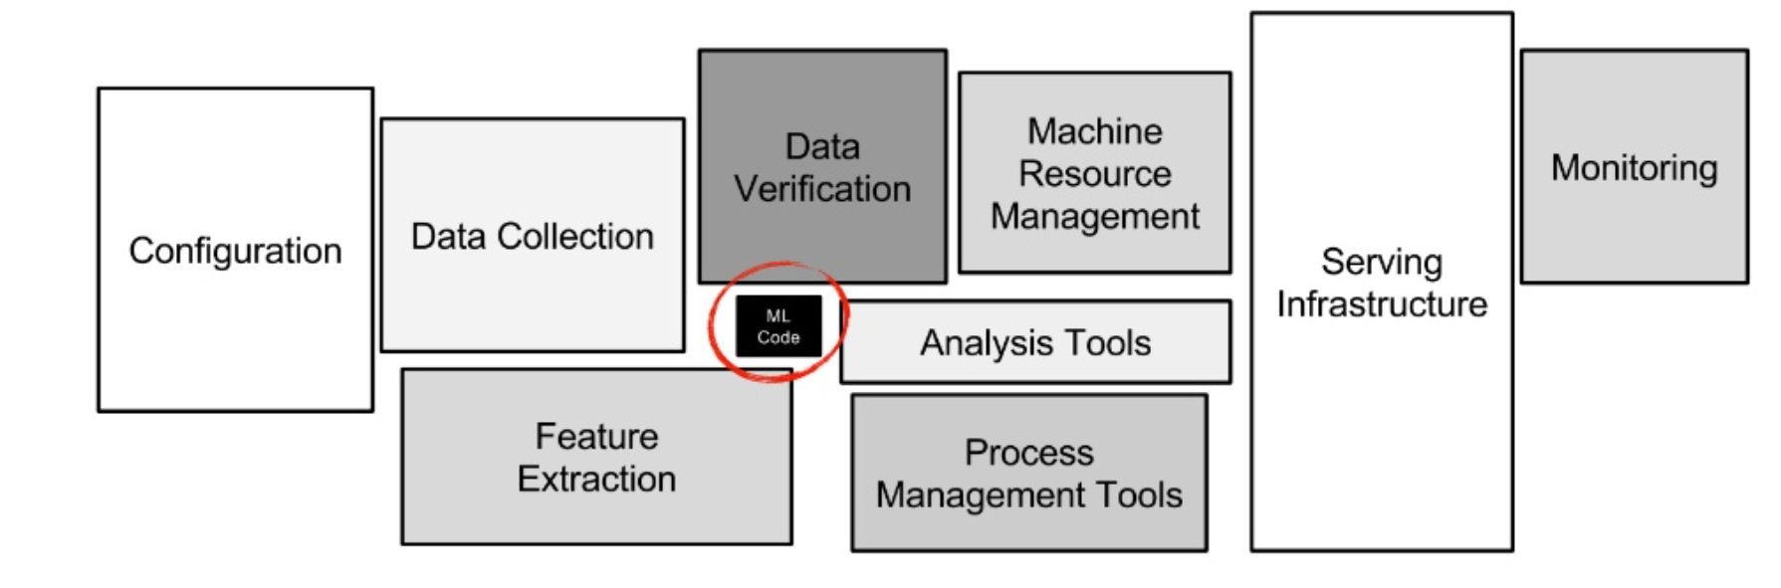
ML code portion in a real-world ML system is a lot smaller than the infrastructure needed for its support.
Notes:
Python Basic Syntax : 1)https://zerotomastery.io/cheatsheets/python-cheat-sheet/ 2) https://www.youtube.com/watch?v=kqtD5dpn9C8&t=579s More detailed: 3) https://www.youtube.com/watch?v=_uQrJ0TkZlc&t=672s Python Projects : Building E-commence Website) : Short Video Series Project : https://www.youtube.com/watch?v=Qr4QMBUPxWo&t=3s Long Video Series Project https://www.youtube.com/watch?v=o9TwipumGoU&list=PLYPlvTh05MsxJja9bzQCSTDu4hnEv5N_u

Slide 12
Read More
Python Basic Syntax :
https://zerotomastery.io/cheatsheets/python-cheat-sheet/
2) https://www.youtube.com/watch?v=kqtD5dpn9C8&t=579s
More detailed:
3) https://www.youtube.com/watch?v=_uQrJ0TkZlc&t=672s
Python Projects : Building E-commence Website) :
Short Video Series Project : https://www.youtube.com/watch?v=Qr4QMBUPxWo&t=3s
Long Video Series Project https://www.youtube.com/watch?v=o9TwipumGoU&list=PLYPlvTh05MsxJja9bzQCSTDu4hnEv5N_u

